Slide 1



SERVICE REGISTRY & DISCOVERY
#1
MICROSERVICES ARCHITECTURE

Slide 3
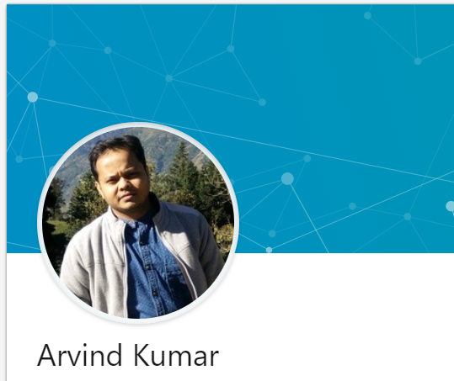
About me
Senior software developer
7+ years of experience
Polyglot programmer
Passion
Facebook – https://www.facebook.com/greenlearner
LinkedIn - https://www.linkedin.com/in/arvind-kumar-108a4b2b/

Slide 4
SERVICE REGISTRY & DISCOVERY
#1
Introduction
MICROSERVICES ARCHITECTURE

Slide 5
Introduction to service registry & discovery
Important for microservices architecture
Client Side service discovery
Server side servicer discovery

Slide 6
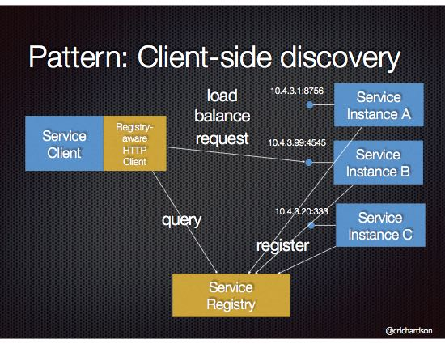
Client Side service discovery
Why
Dynamic change in number and location of services
Dynamic URL when deployed in cloud
Solution
Some kind of registration service
Dynamic maintenance of microservice urls
Netflix Eureka is a service registry

Slide 7
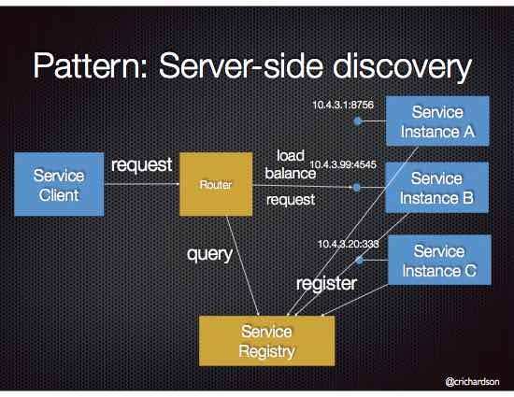
Server side servicer discovery
AWS Elastic Load Balancer (ELB)

Slide 8
SERVICE REGISTRY & DISCOVERY
#1
Demo – spring boot + eureka
MICROSERVICES ARCHITECTURE

Slide 9
Introduction to service registry & discovery

Slide 10
Introduction to service registry & discovery

Slide 11
Introduction to service registry & discovery

Slide 12
Introduction to service registry & discovery

Slide 13
Introduction to service registry & discovery

Slide 14
Introduction to service registry & discovery

Slide 15
Introduction to service registry & discovery

Slide 16
Introduction to service registry & discovery

